Slide 1
DAPO program application
Phase-1
Layout

Slide 2
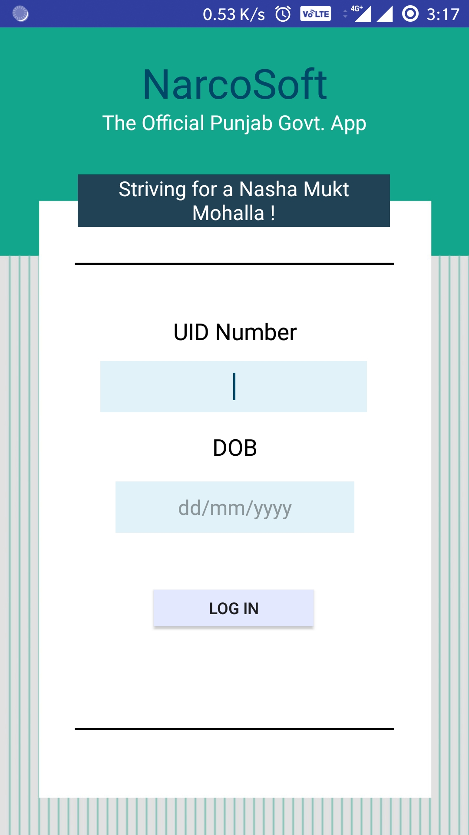
Login screen
LOGIN WILL BE DONE HERE
UNIQUE IDENTIFICATION NUMBER
DATE OF BIRTH

Slide 3
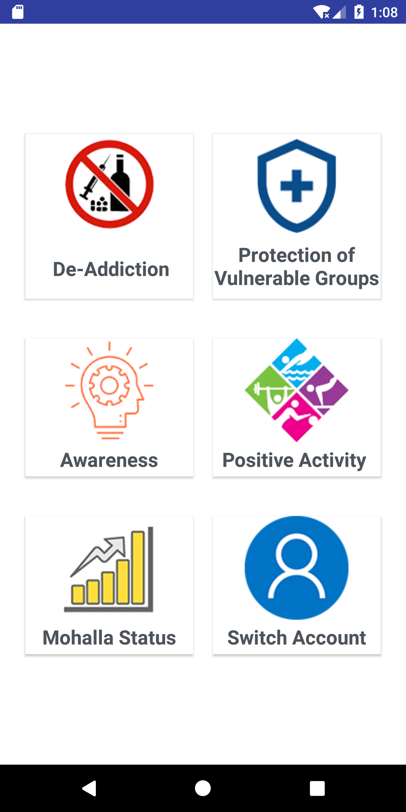
Main task page
Various subheadings available to choose for respective activity performed

Slide 4
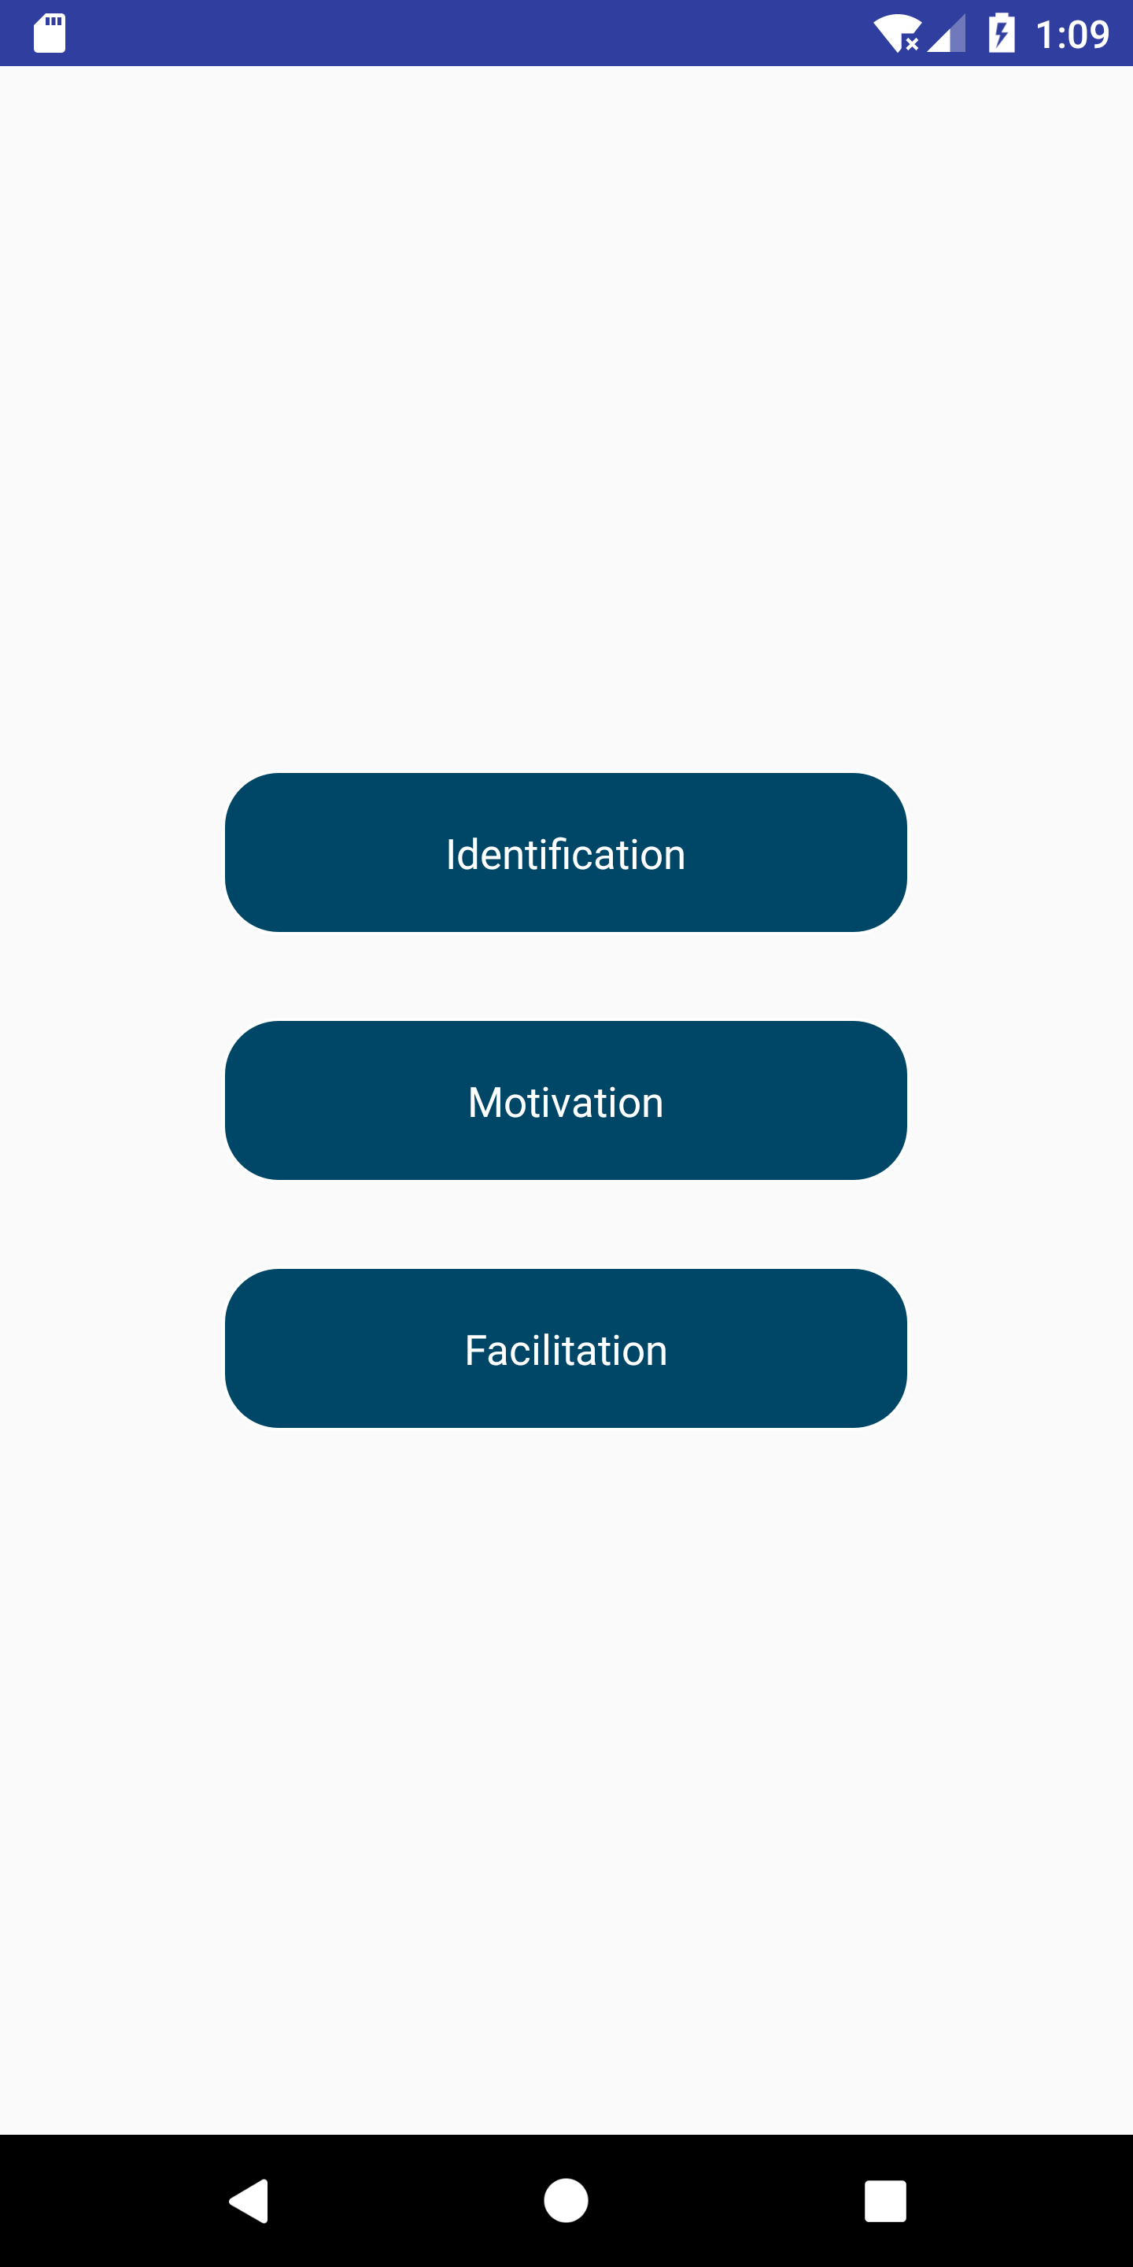
DE-ADDICTION
ACTIVITIES UNDER DE ADDICTION DIVIDED INTO 3 CATEGORIES

Slide 5
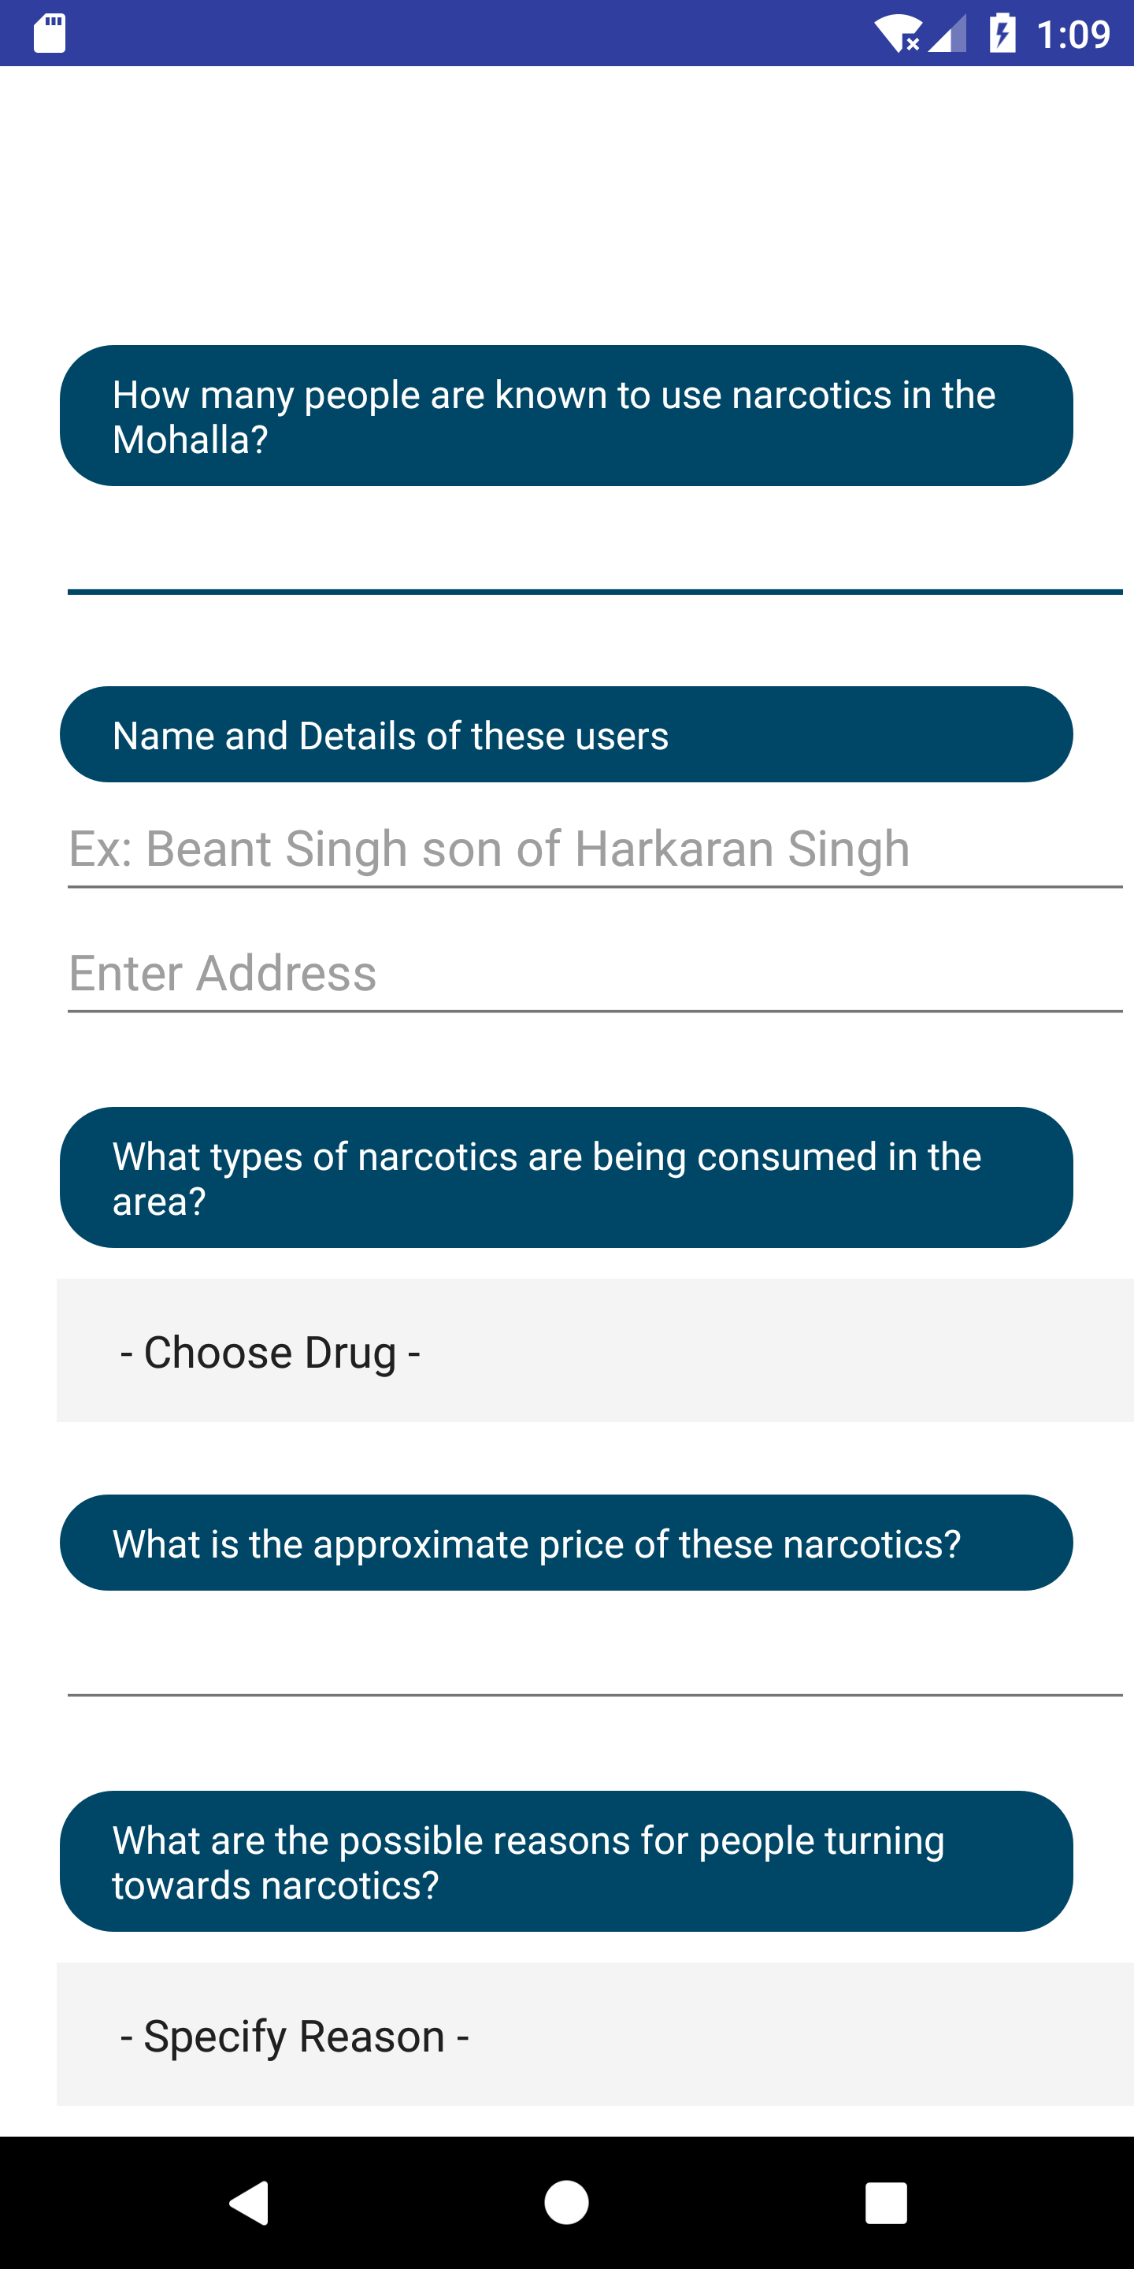
DE-ADDICTION
IDENTIFICATION
Information gathered and efforts made regarding narcotics and users

Slide 6
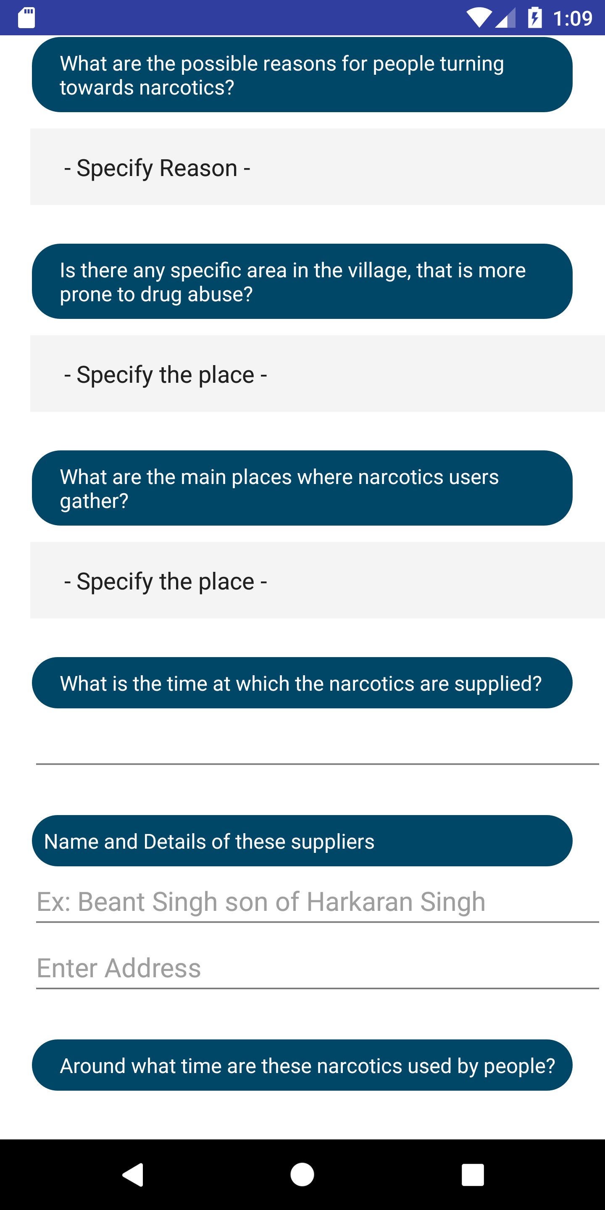
DE-ADDICTION
IDENTIFICATION
Information gathered and efforts made regarding narcotics and users

Slide 7
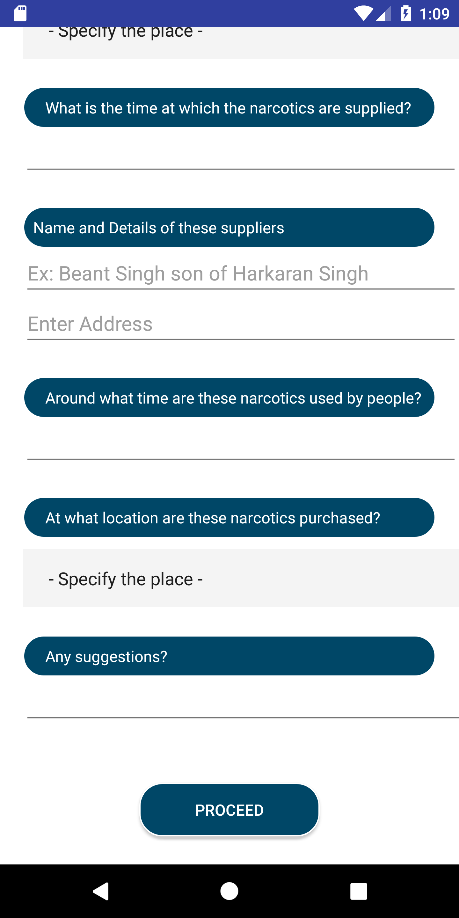
DE-ADDICTION
IDENTIFICATION
Information gathered and efforts made regarding narcotics and users

Slide 8
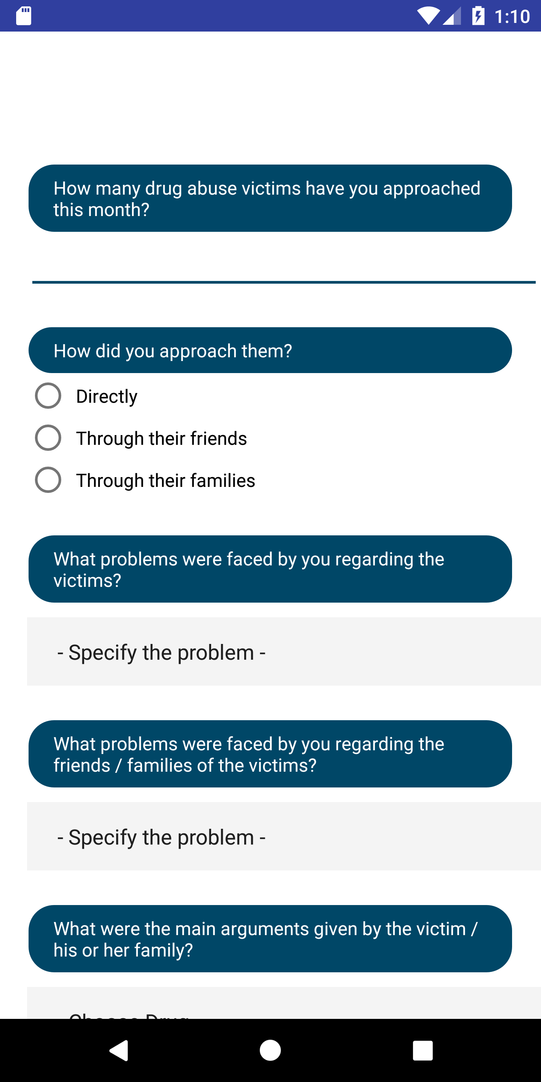
DE-ADDICTION
MOTIVATION
Efforts made to make drug users aware of the ill effects of drug abuse and to persuade them to get appropriate treatment for rehabilitation

Slide 9
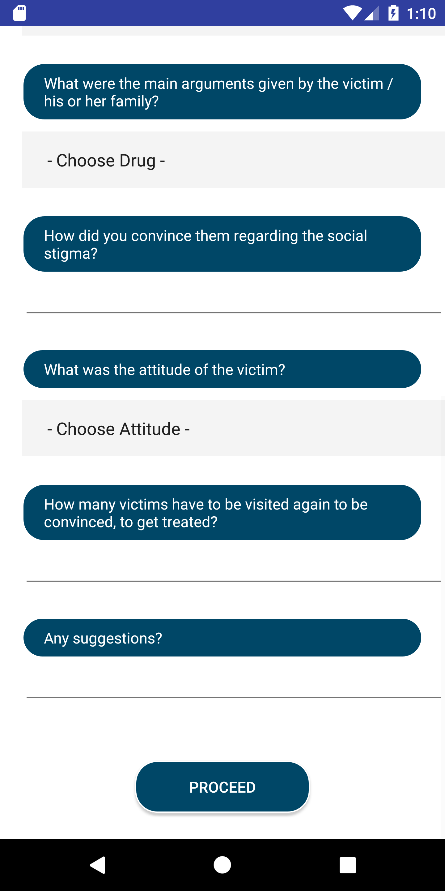
DE-ADDICTION
MOTIVATION
Efforts made to make drug users aware of the ill effects of drug abuse and to persuade them to get appropriate treatment for rehabilitation

Slide 10
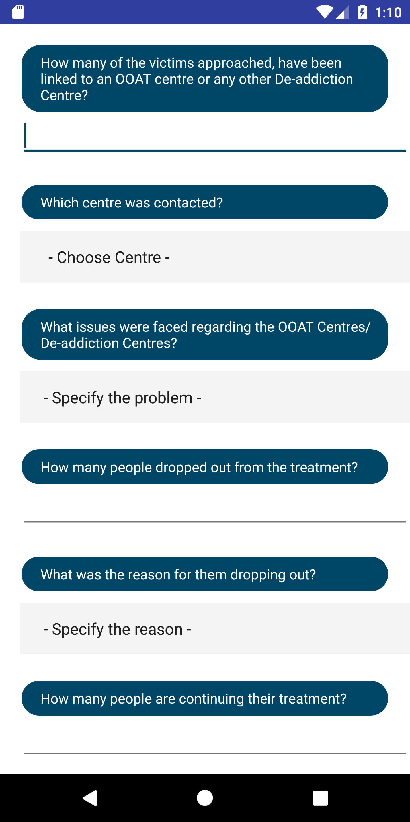
DE-ADDICTION
FACILITATION
Treatment of the drug abuse victims
Linking them to OAAT/De-Addiction Centres
Rehabilitation Details
Follow-ups on their treatment

Slide 11
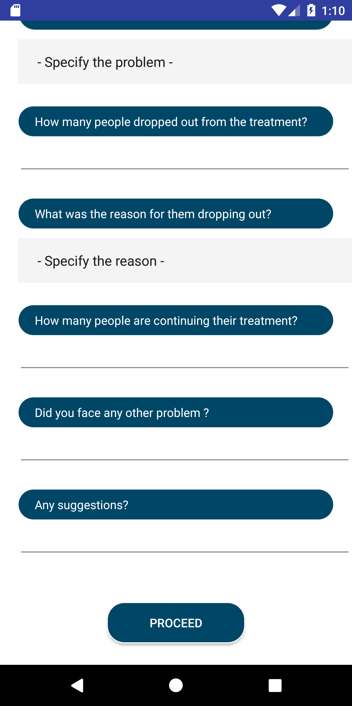
DE-ADDICTION
FACILITATION
Treatment of the drug abuse victims
Linking them to OAAT/De-Addiction Centres
Rehabilitation Details
Follow-ups on their treatment

Slide 12
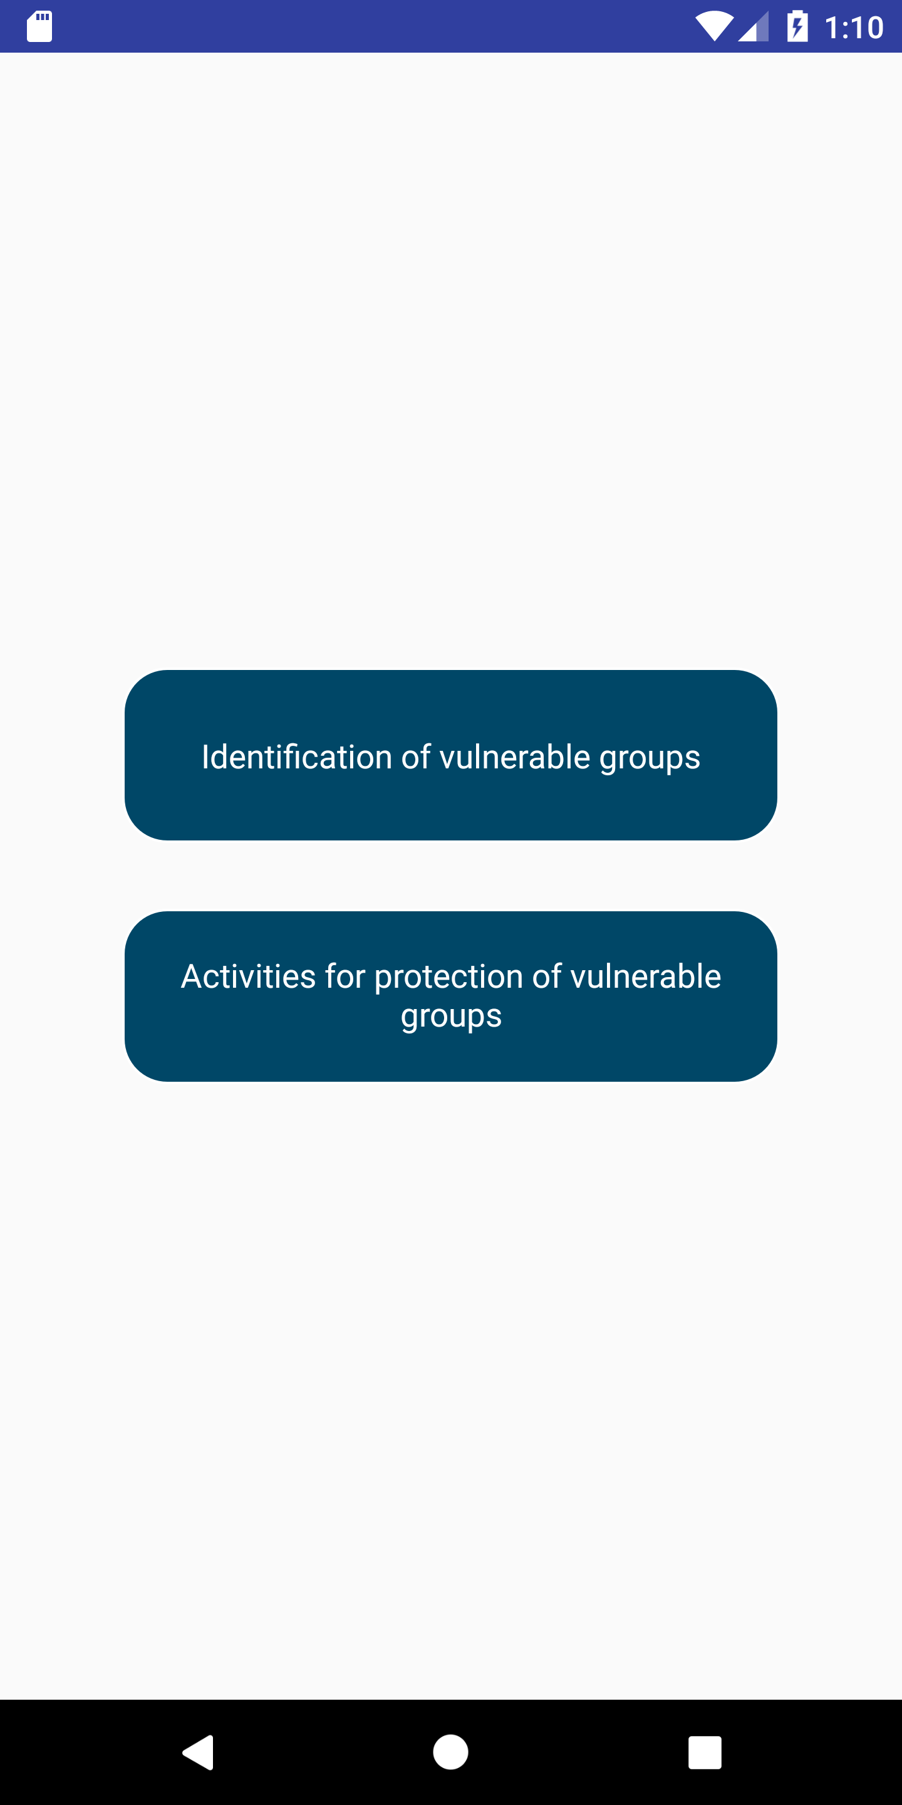
PROTECTION
Identification Of The Vulnerable Groups
Protection Of The Vulnerable Groups

Slide 13
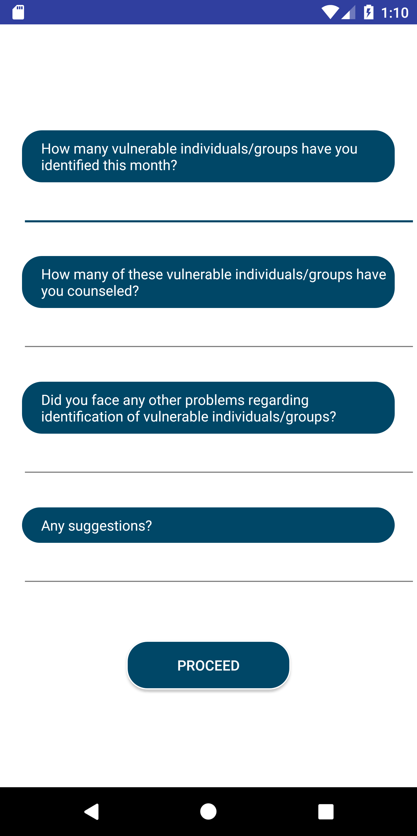
PROTECTION
Identifying potential drug users and vulnerable groups like the social circle of drug abuse victims

Slide 14
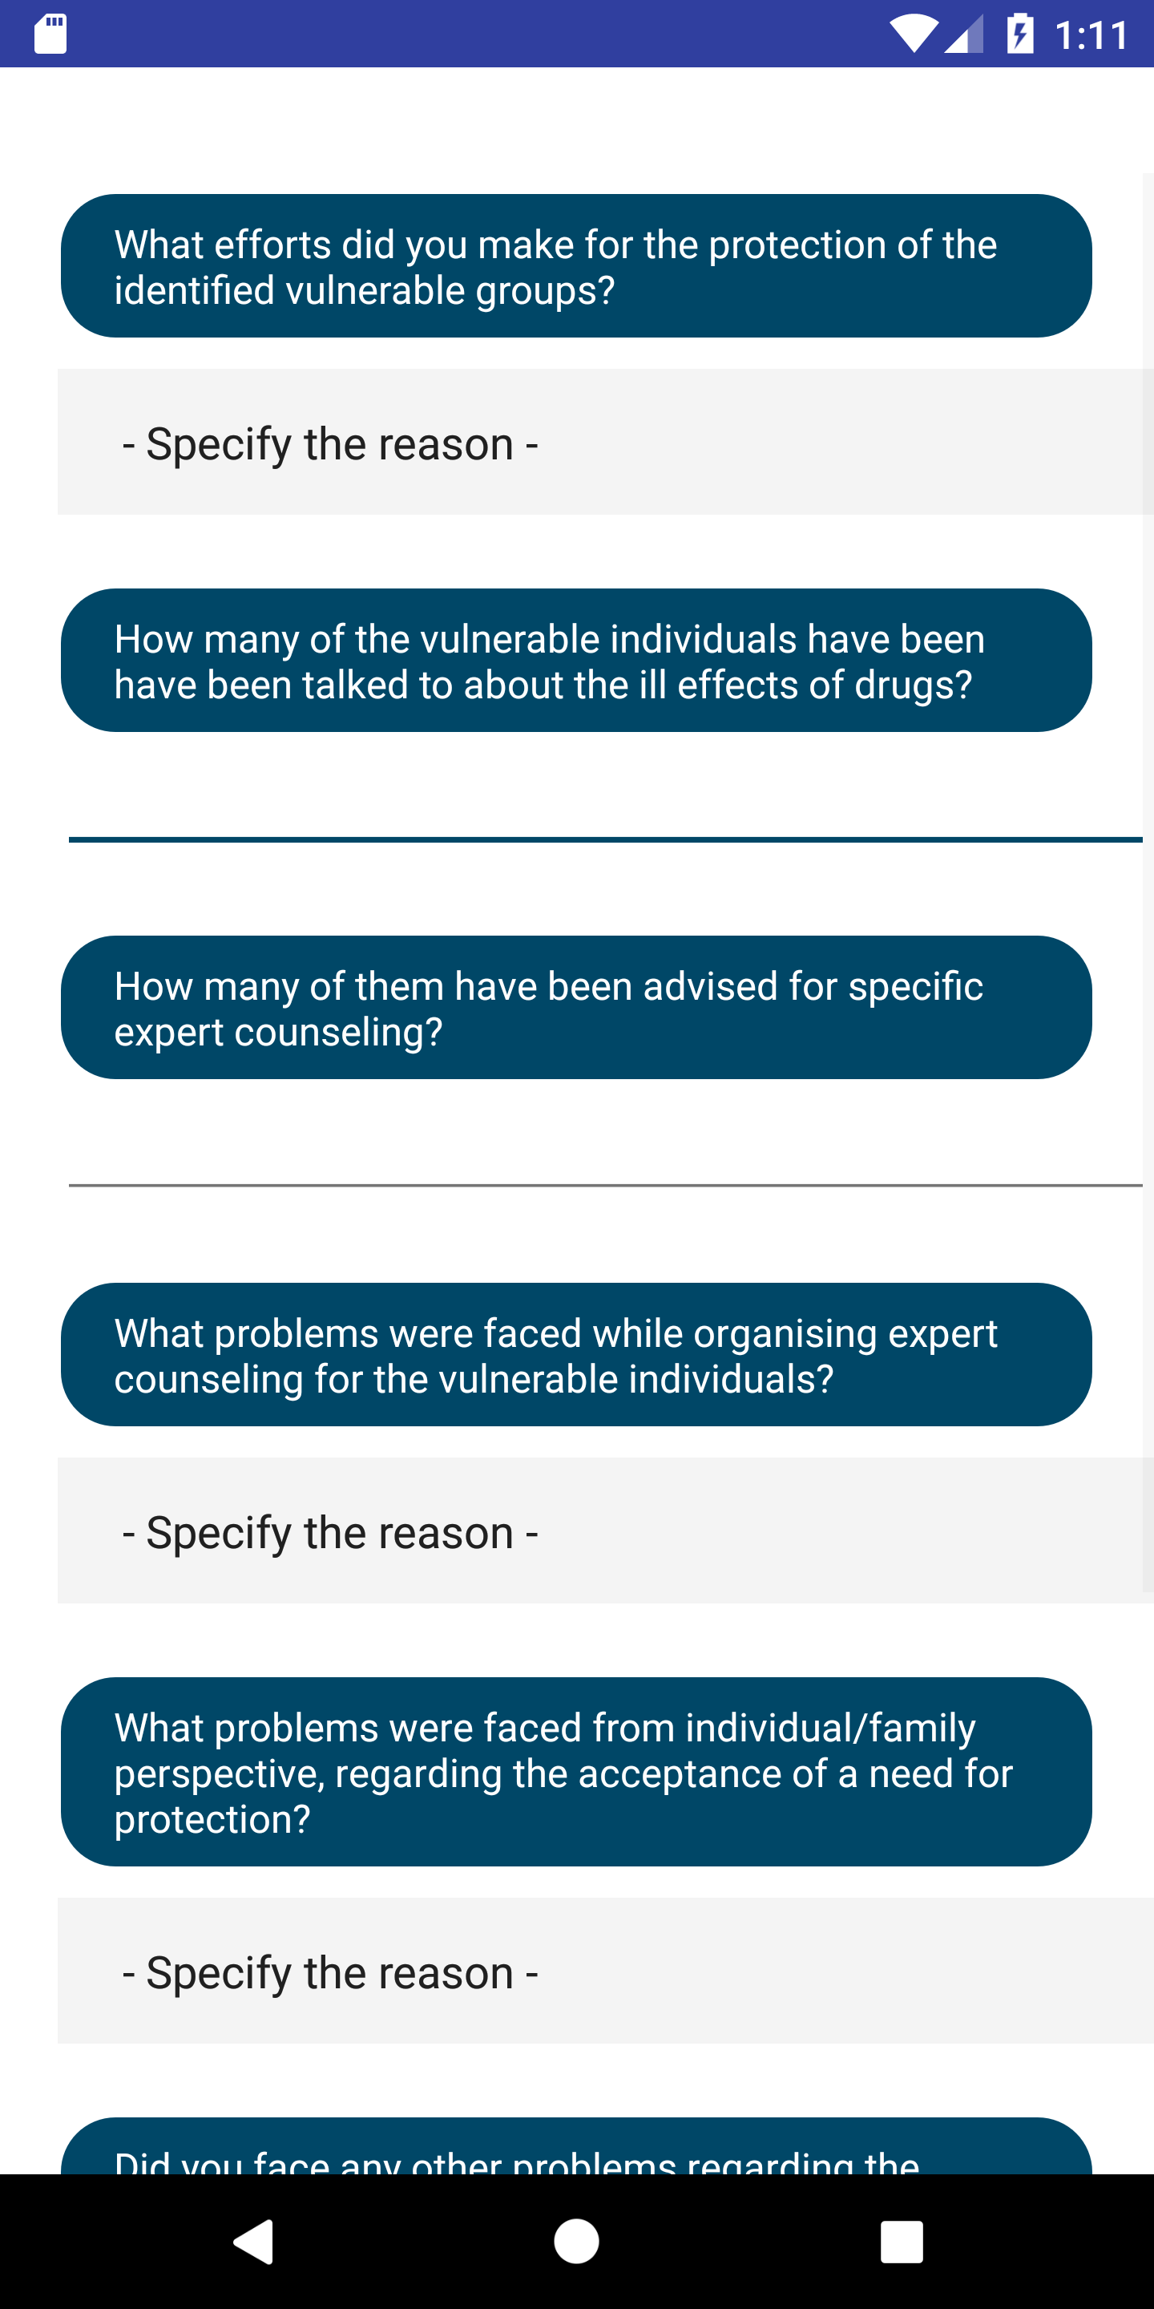
PROTECTION
- Specify -
Efforts made to keep said vulnerable groups away from drugs

Slide 15
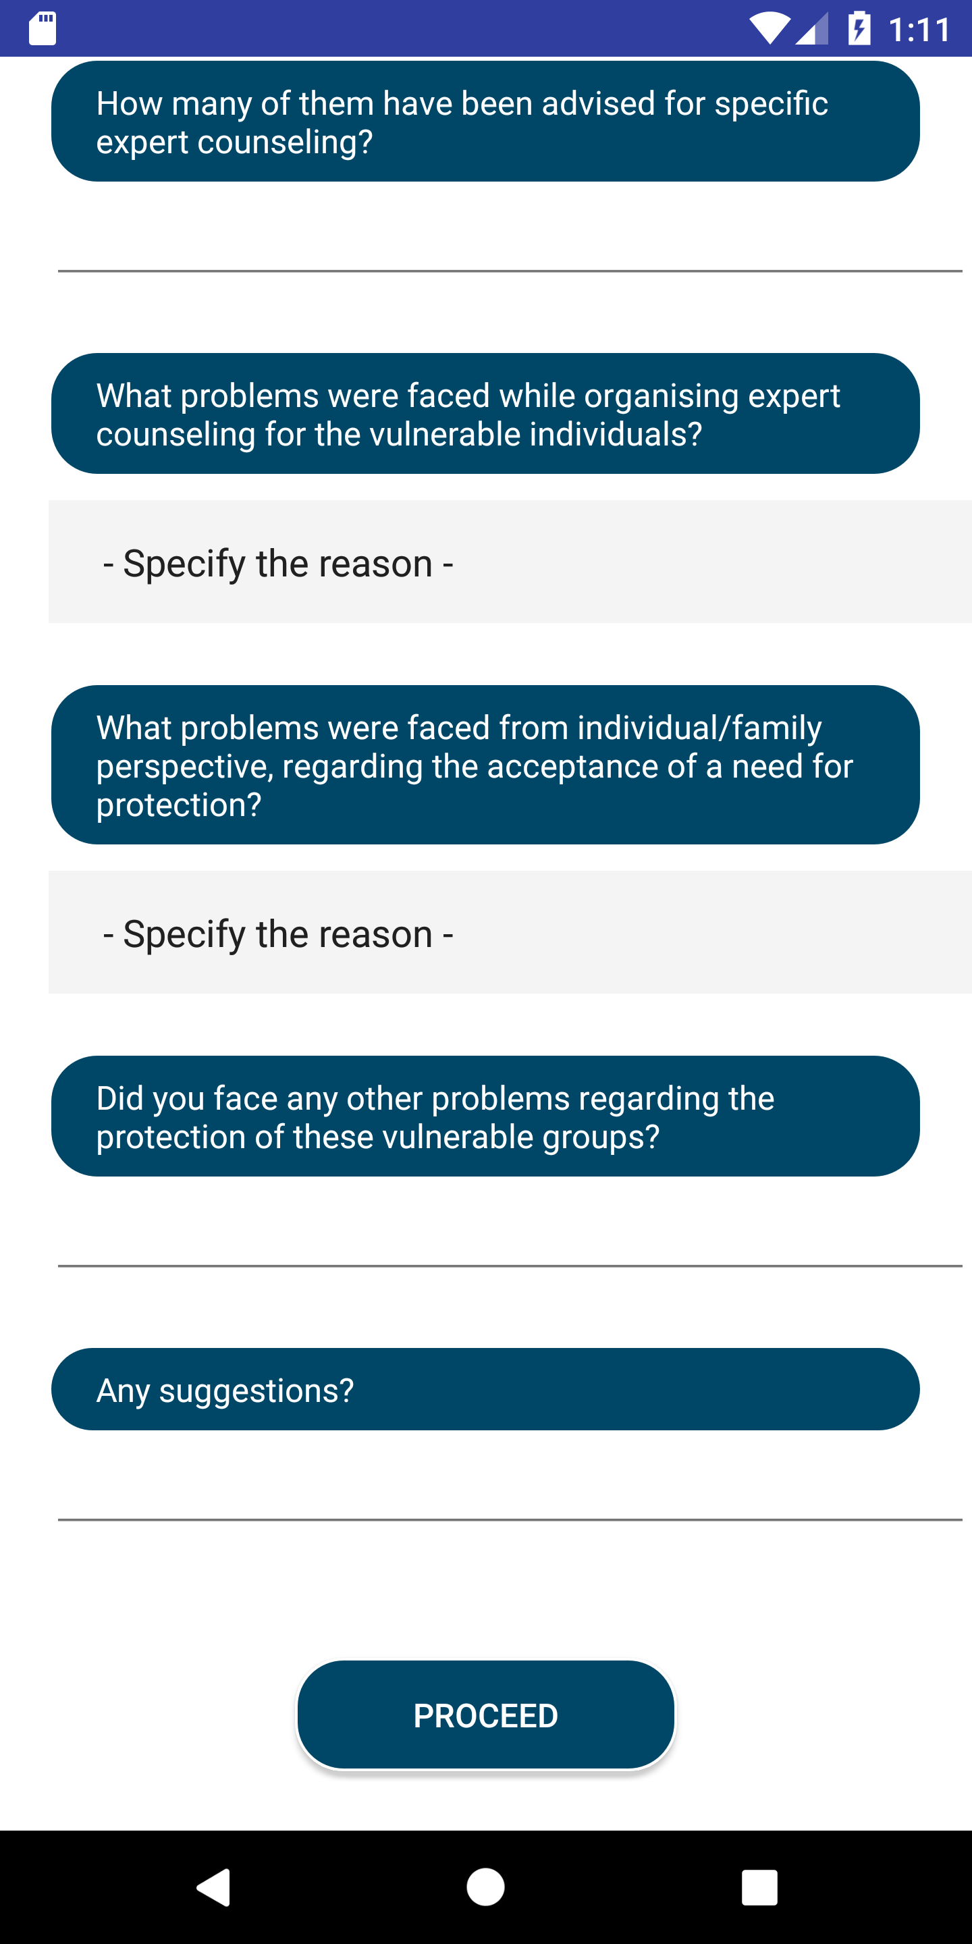
PROTECTION
Efforts made to keep said vulnerable groups away from drugs

Slide 16
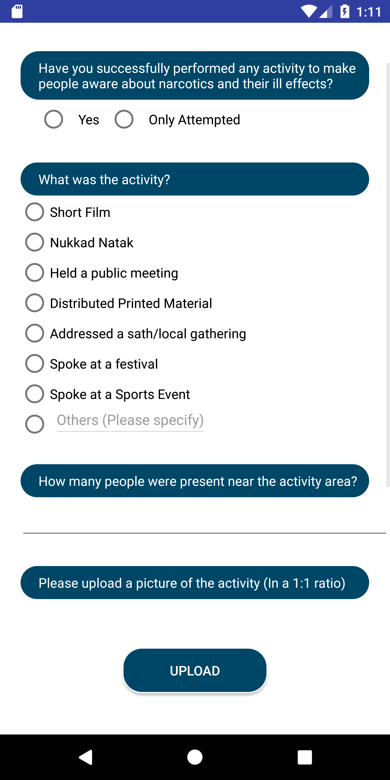
AWARENESS
Efforts made to make people aware of the ill effects of narcotics

Slide 17
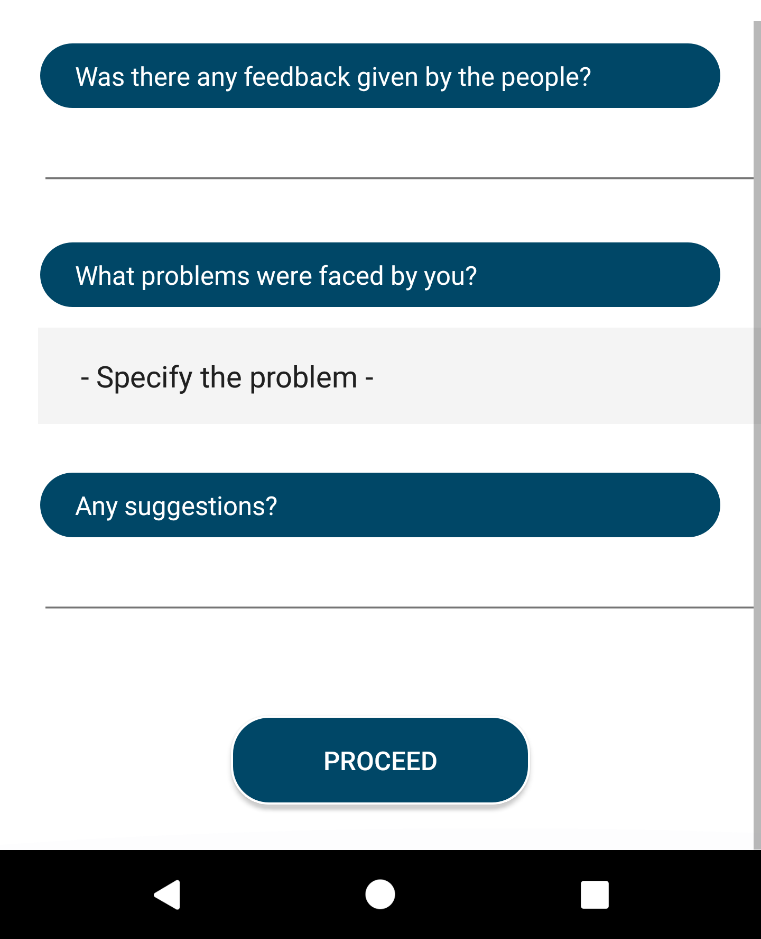
AWARENESS
Efforts made to make people aware of the ill effects of narcotics

Slide 18
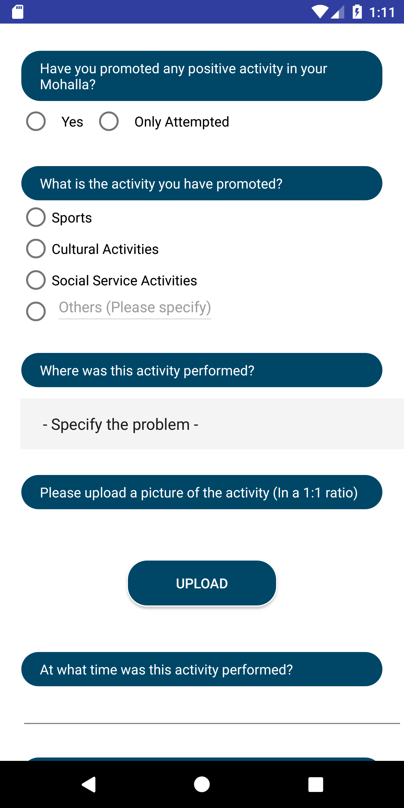
Positive activities
Efforts made to promote people’s involvement in positive activities and to keep them busy thus promoting a healthy lifestyle

Slide 19
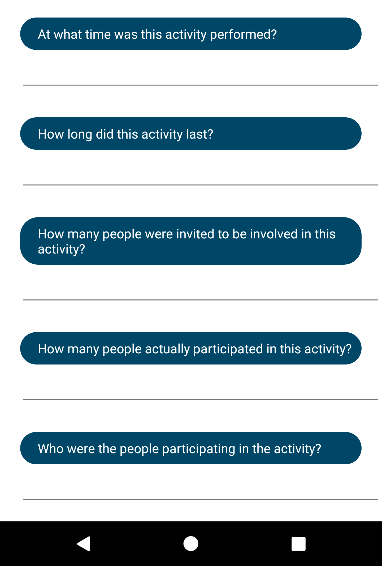
Positive activities
Efforts made to promote people’s involvement in positiveactivities and to keep them busy thus promoting a healthy lifestyle

Slide 20
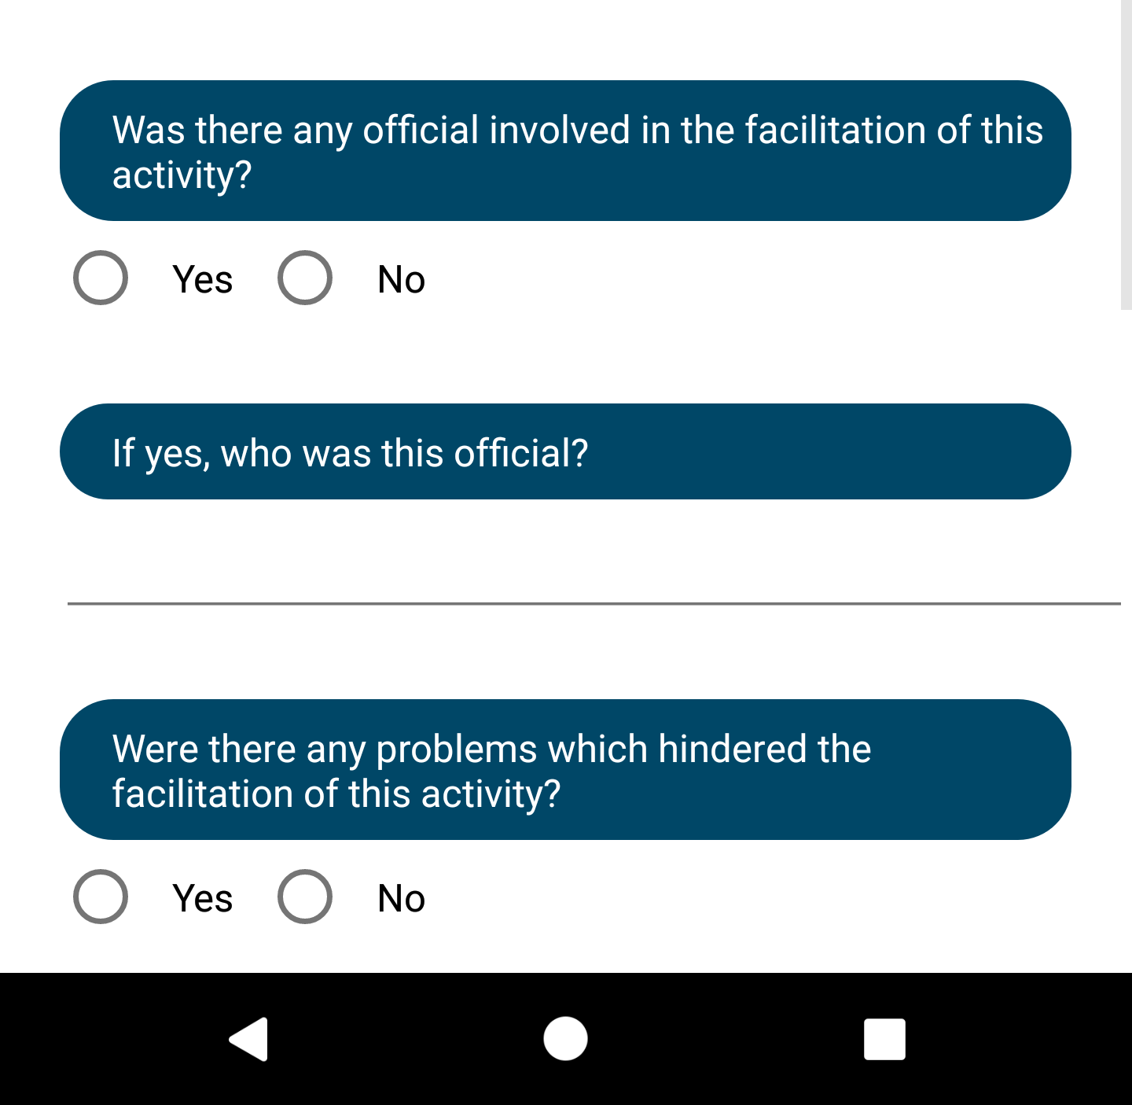
Positive activities
Efforts made to promote people’s involvement in positiveactivities and to keep them busy thus promoting a healthy lifestyle

Slide 21
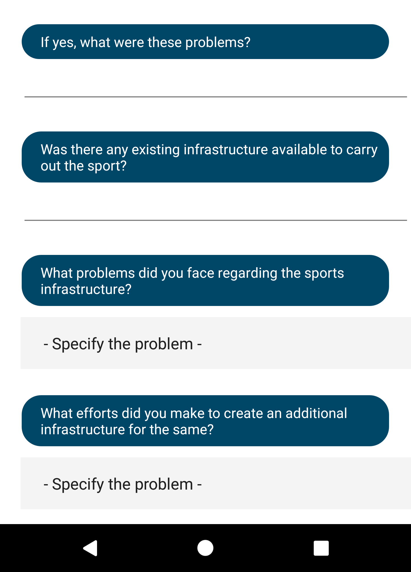
Positive activities
Efforts made to promote people’s involvement in positiveactivities and to keep them busy thus promoting a healthy lifestyle

Slide 22
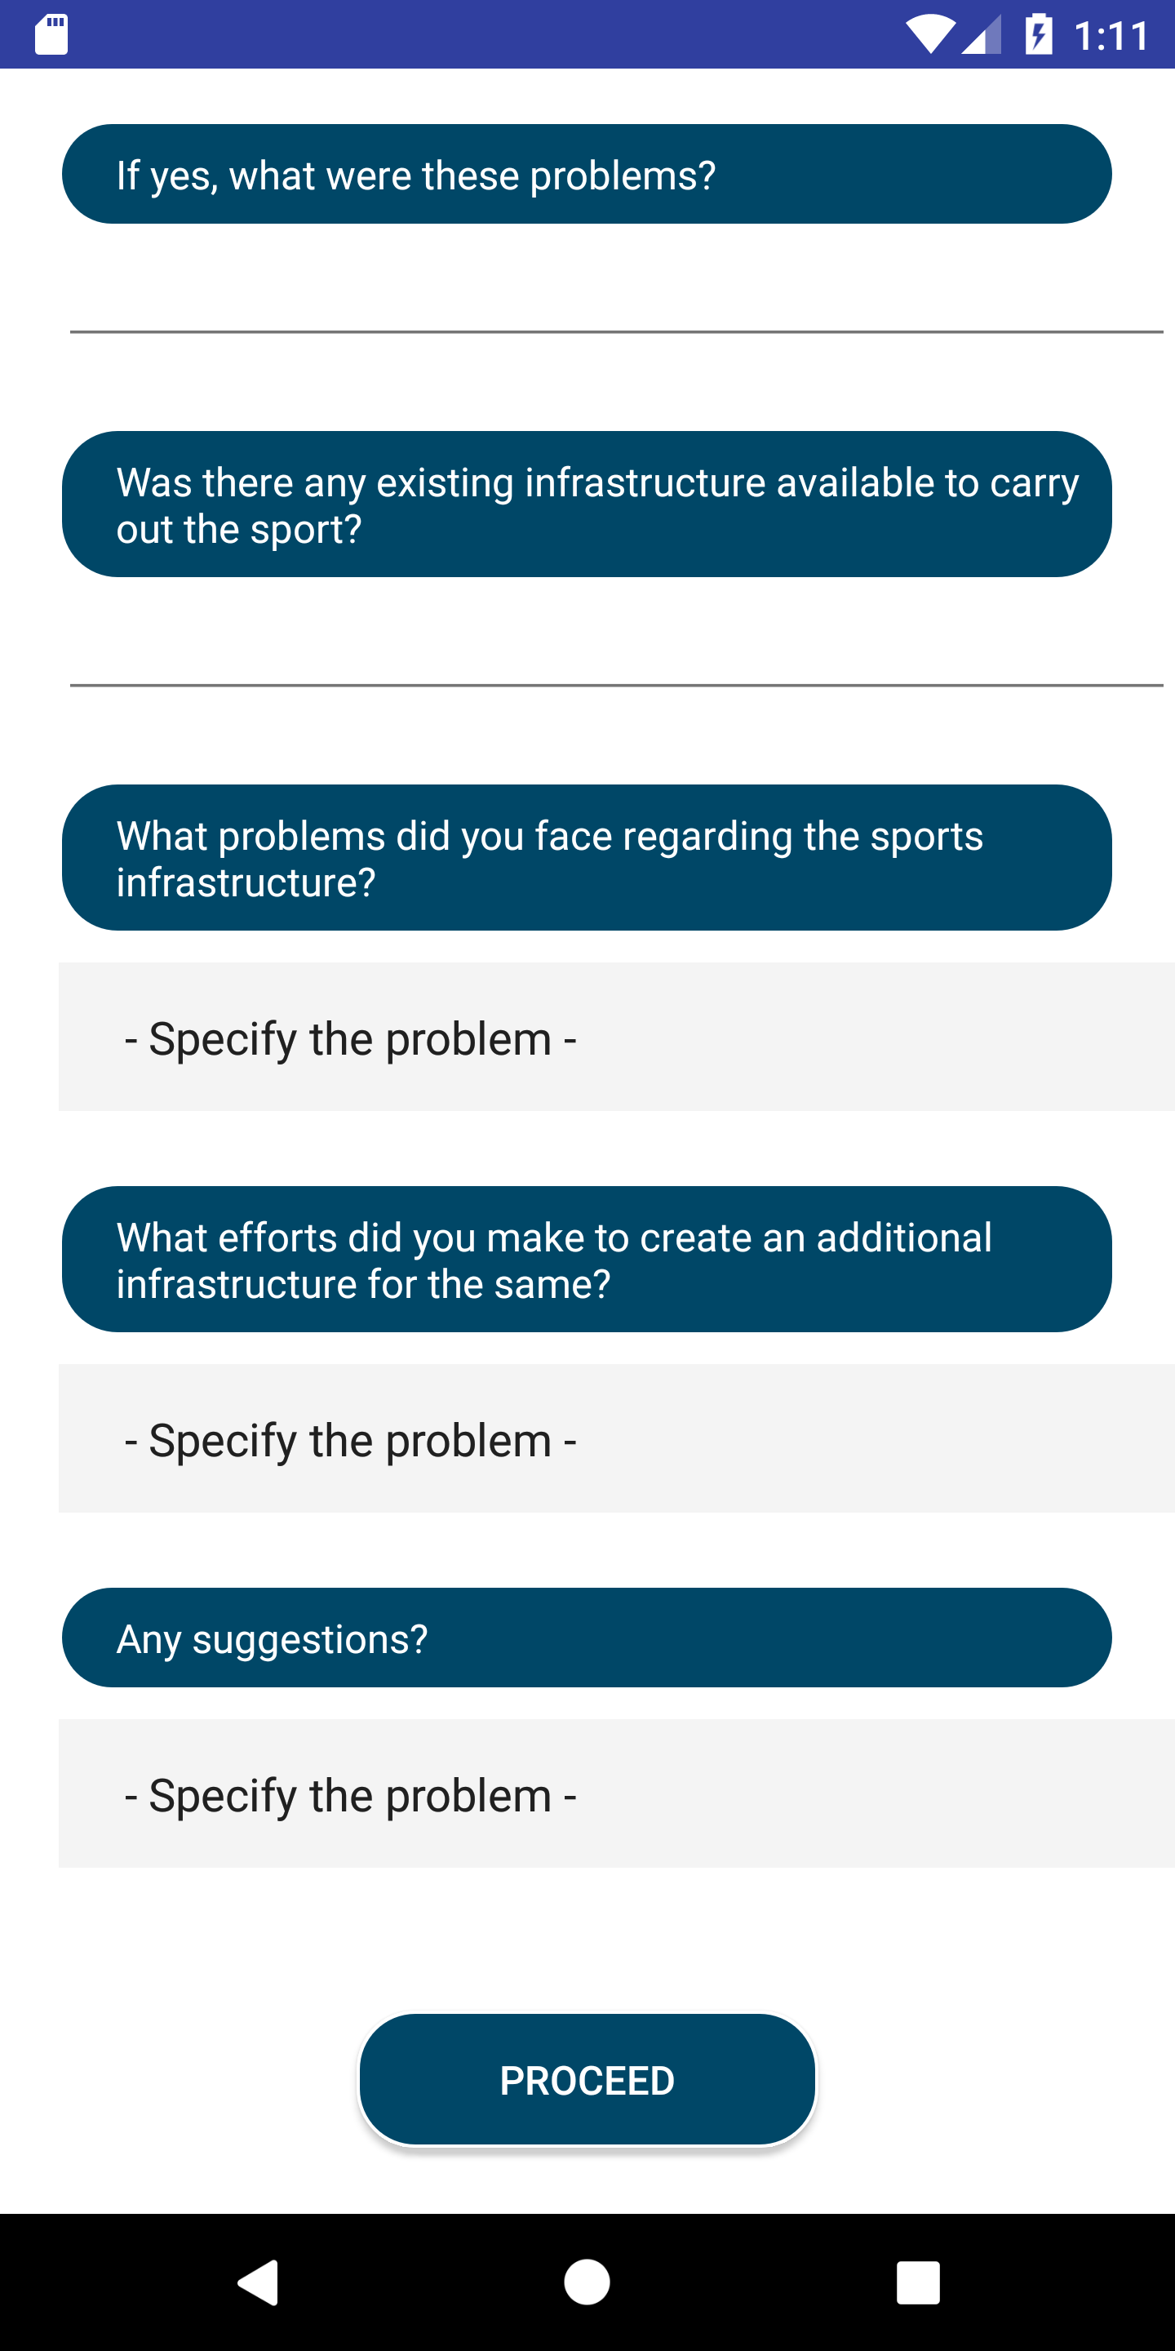
Positive activities
Efforts made to promote people’s involvement in positiveactivities and to keep them busy thus promoting a healthy lifestyle

Slide 23
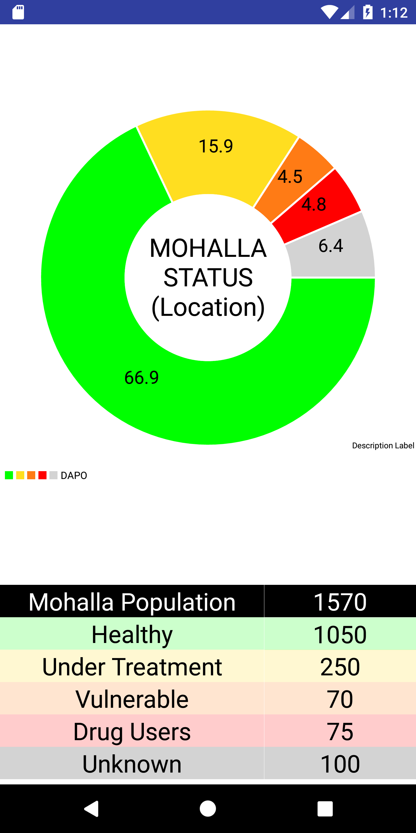
Mohalla status
Pie chart representation of the mohalla’s population status

Slide 24
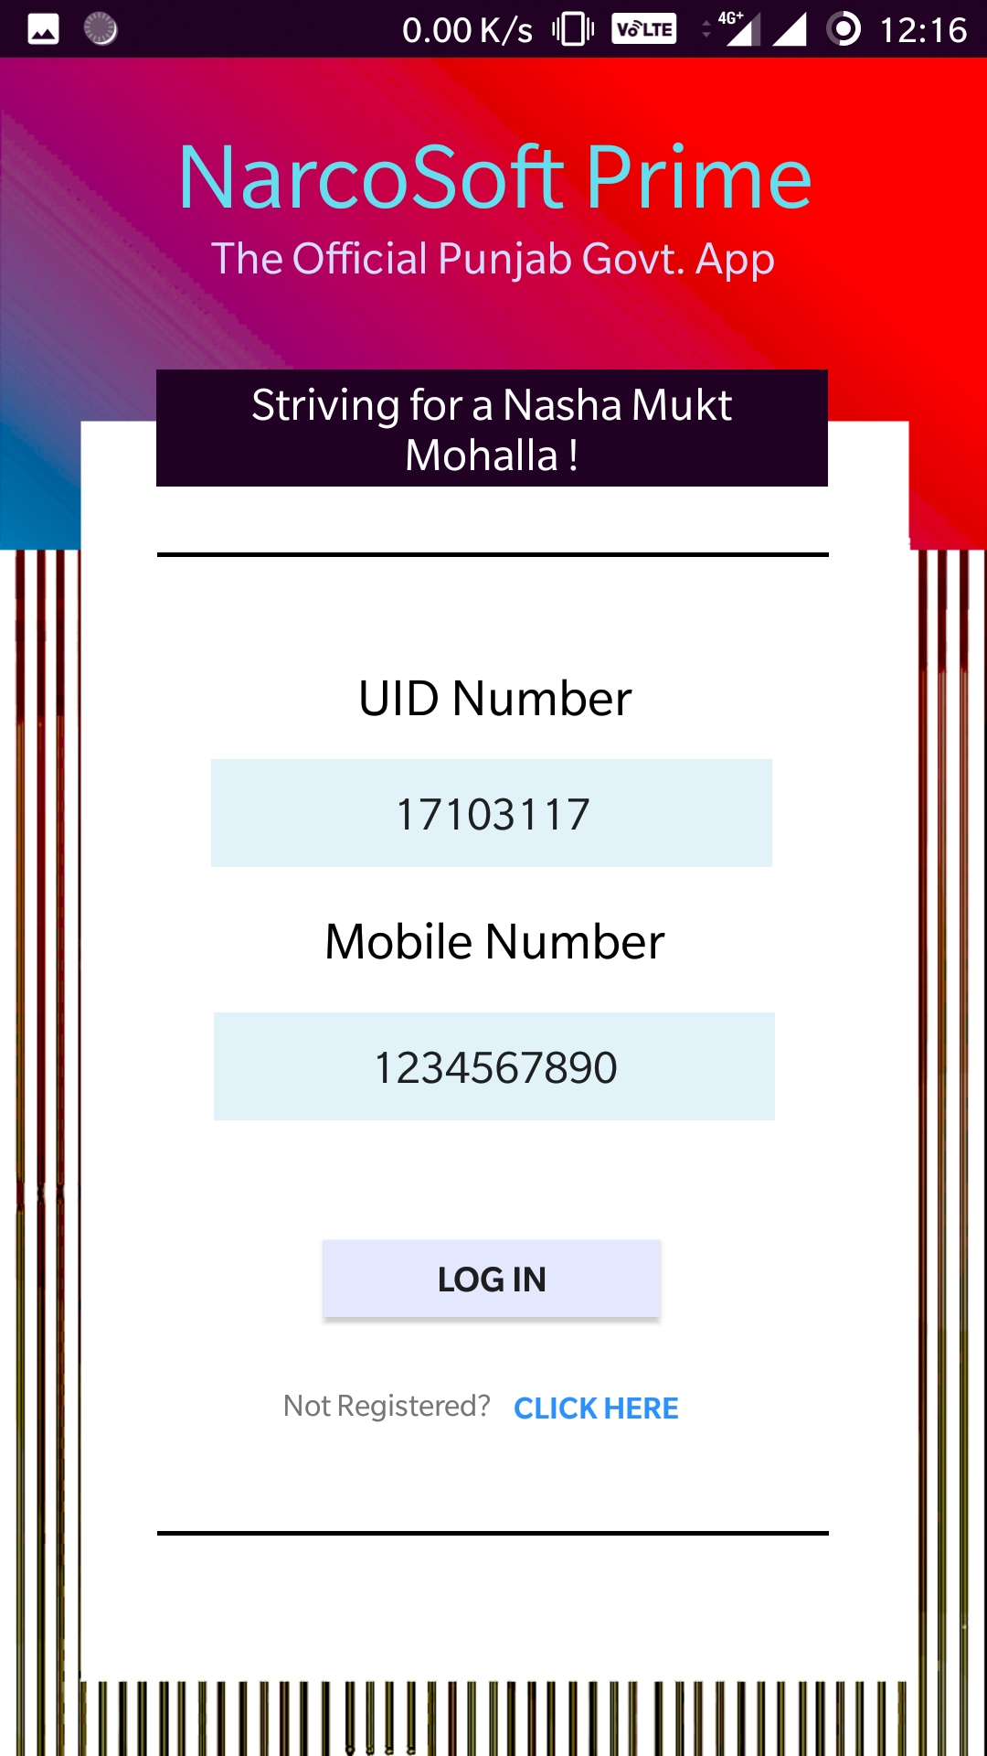
Mohalla status
Pie chart representation of the mohalla’s population status

Slide 25
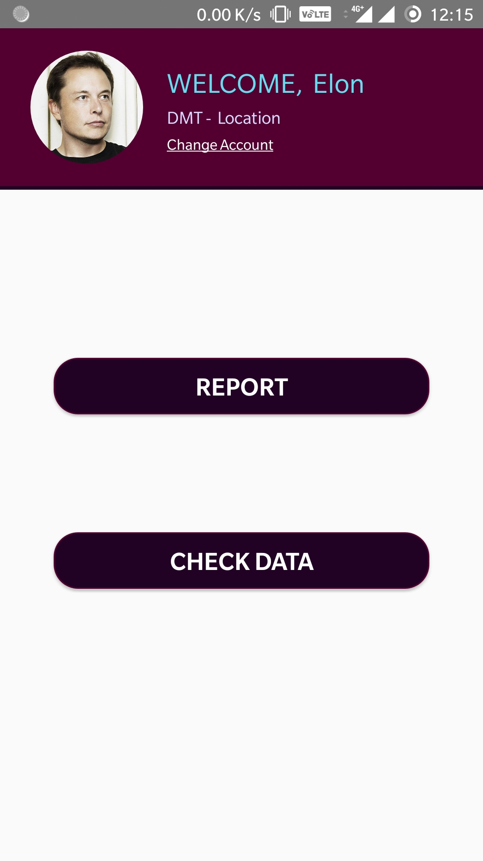
Mohalla status
Pie chart representation of the mohalla’s population status

Slide 26
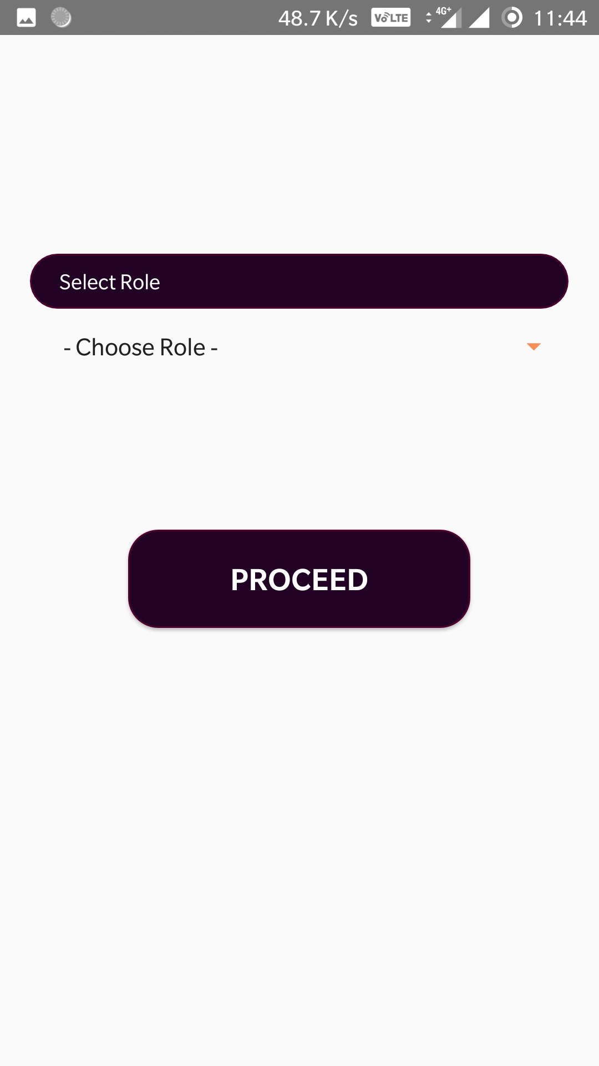
Mohalla status
Pie chart representation of the mohalla’s population status

Slide 27
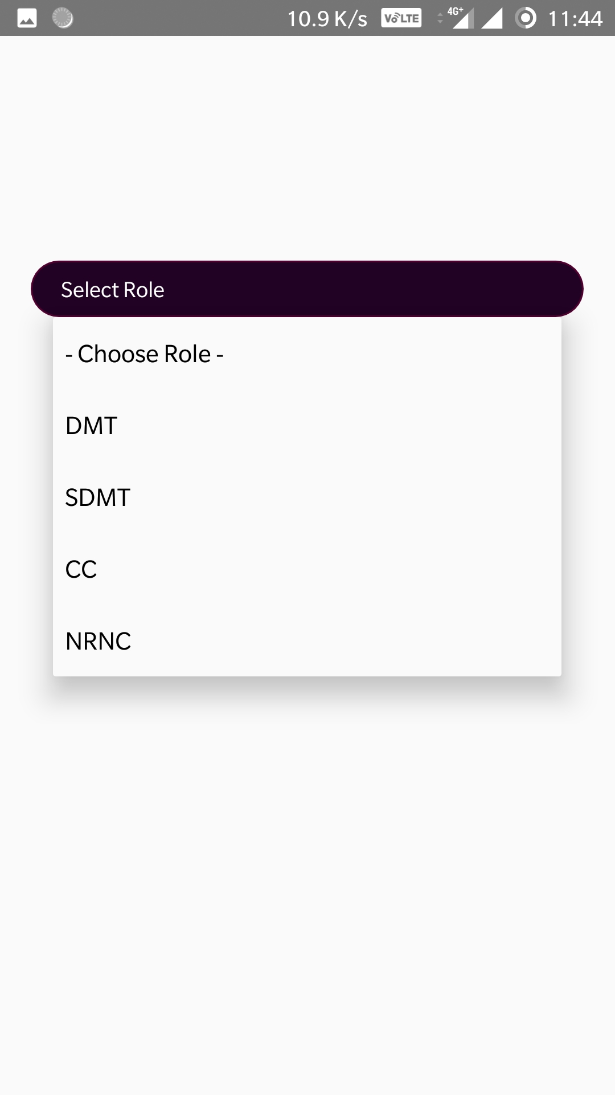
Mohalla status
Pie chart representation of the mohalla’s population status

Slide 28
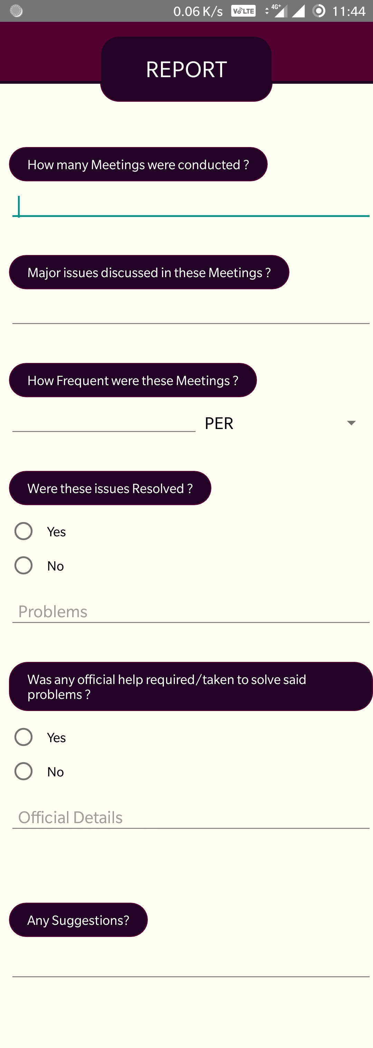
Mohalla status
Pie chart representation of the mohalla’s population status

Slide 29
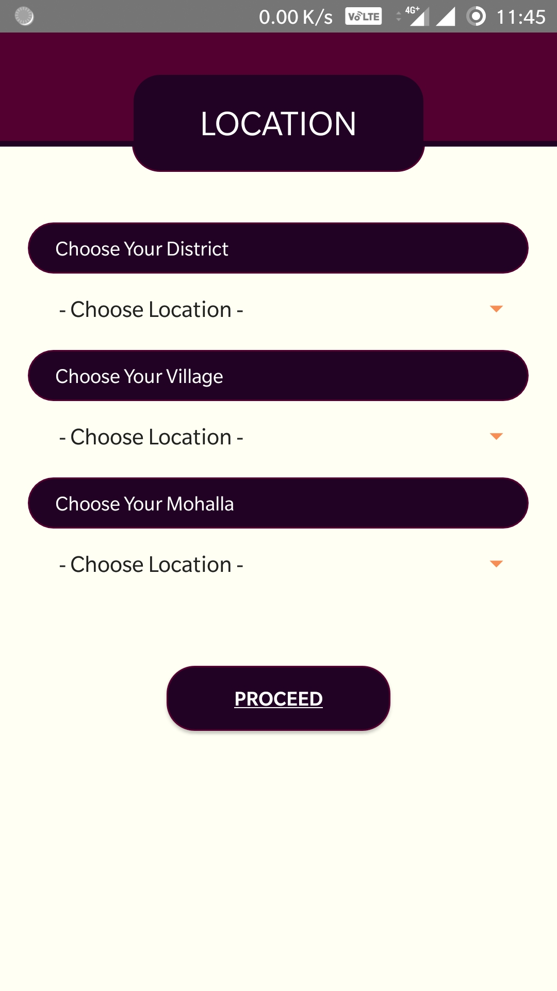
Mohalla status
Pie chart representation of the mohalla’s population status

Slide 30
APPS FOR HIGHER LEVELS
Corresponding apps for NRNC ,CC , SDMT , DMT and STF levels

Slide 31
Login screens

Slide 32
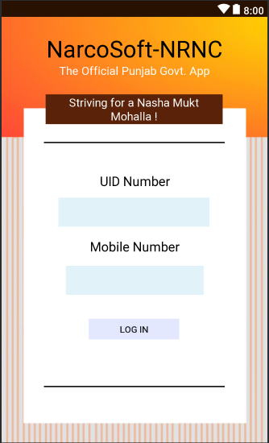
NRNC

Slide 33
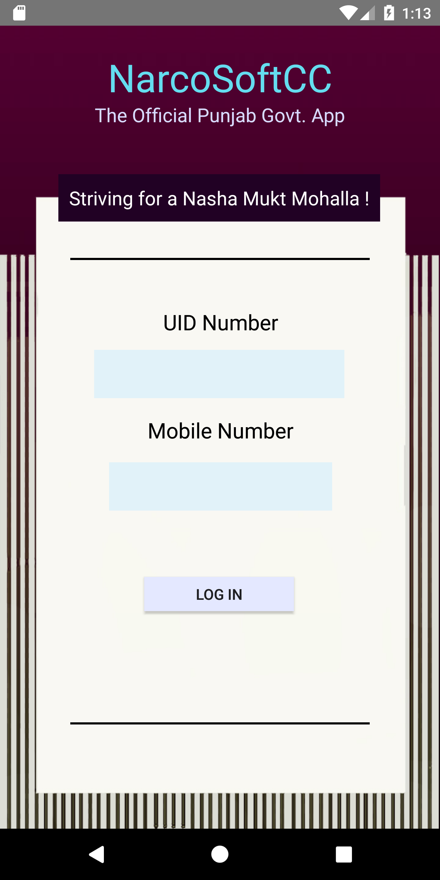
CC

Slide 34
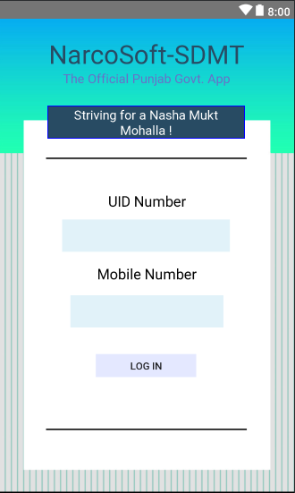
SDMT

Slide 35
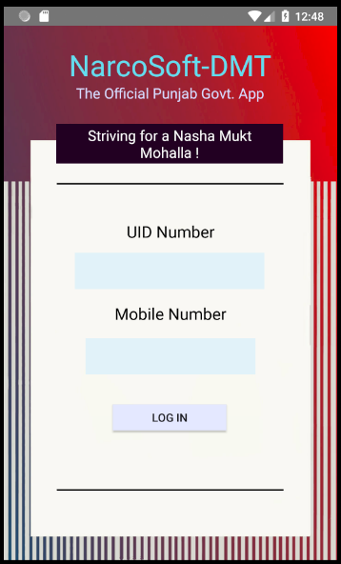
DMT

Slide 36
Special task force (stf) application
Corresponding application for use by STF

Slide 37
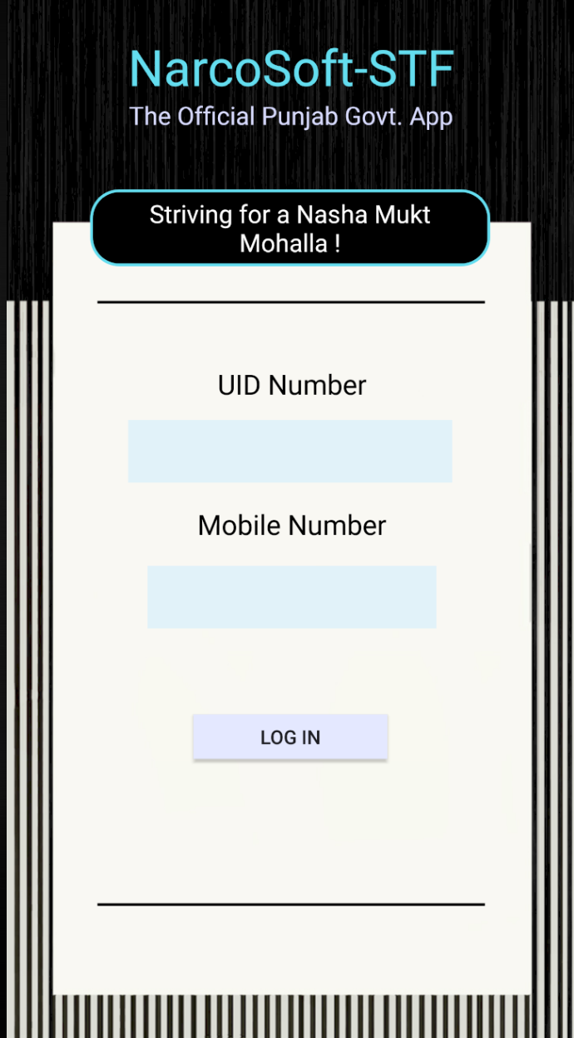
STF
Login Page

Slide 38
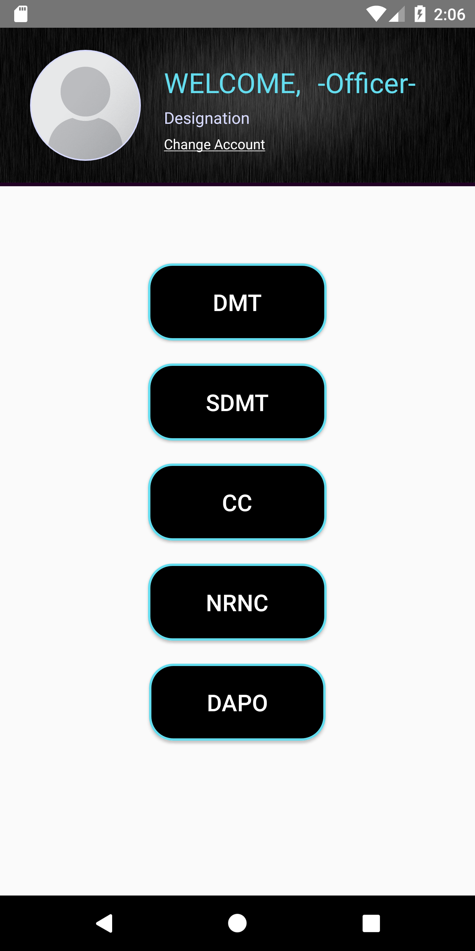
HOME PAGE
List of buttons to check the corresponding levels of hierarchy and their data

Slide 39
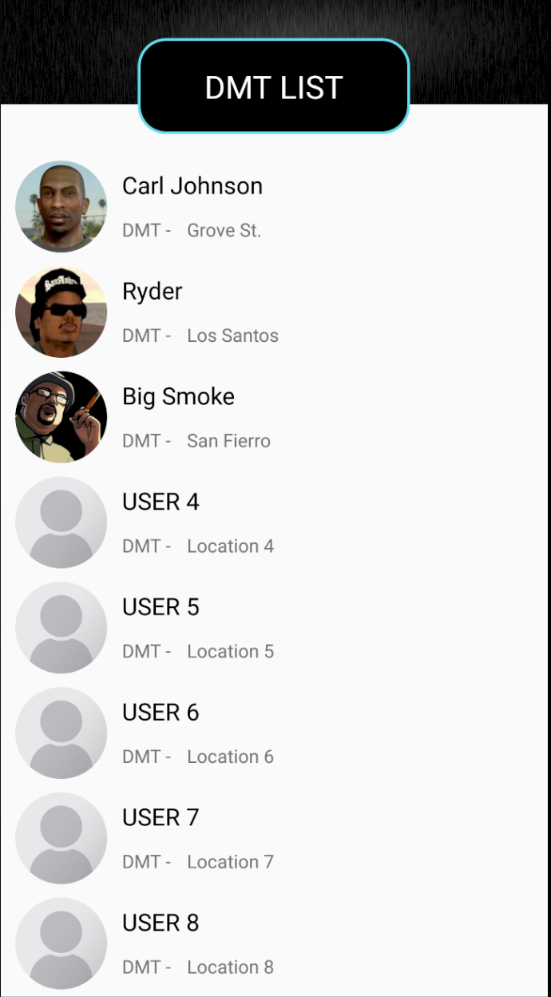
List of people under the hierarchical level
Corresponding list items can be clicked for respective info

Slide 40
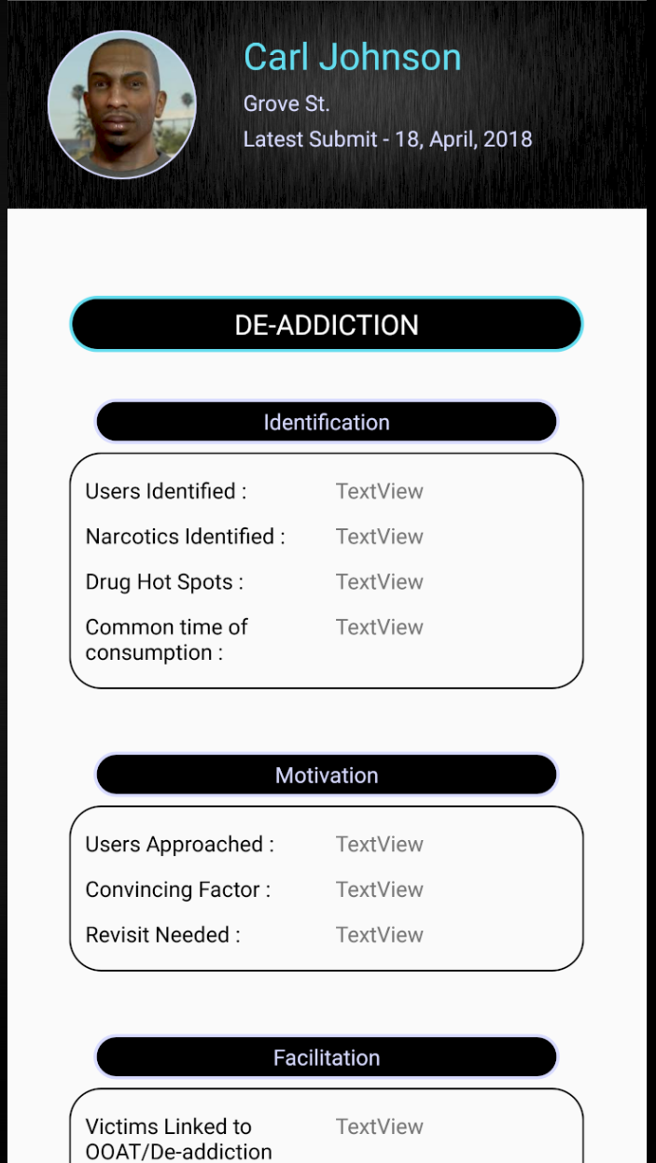
BRIEF PROGRESS
Shortened version of DAPO’s activities

Slide 41
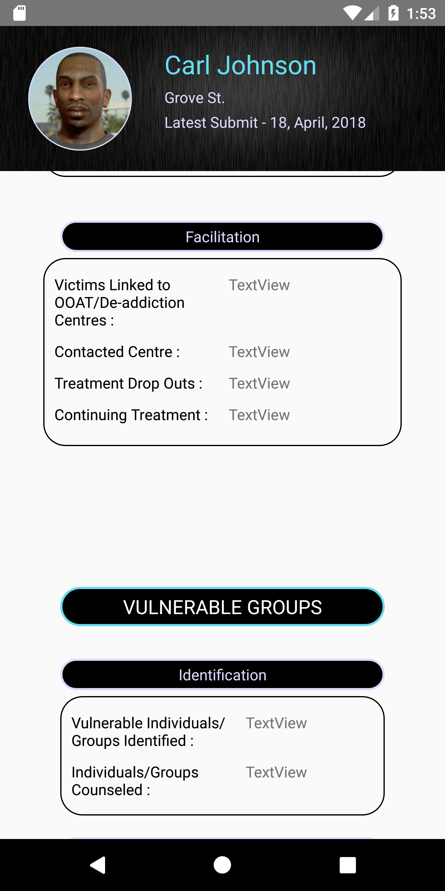
BRIEF PROGRESS
Shortened version of DAPO’s activities

Slide 42
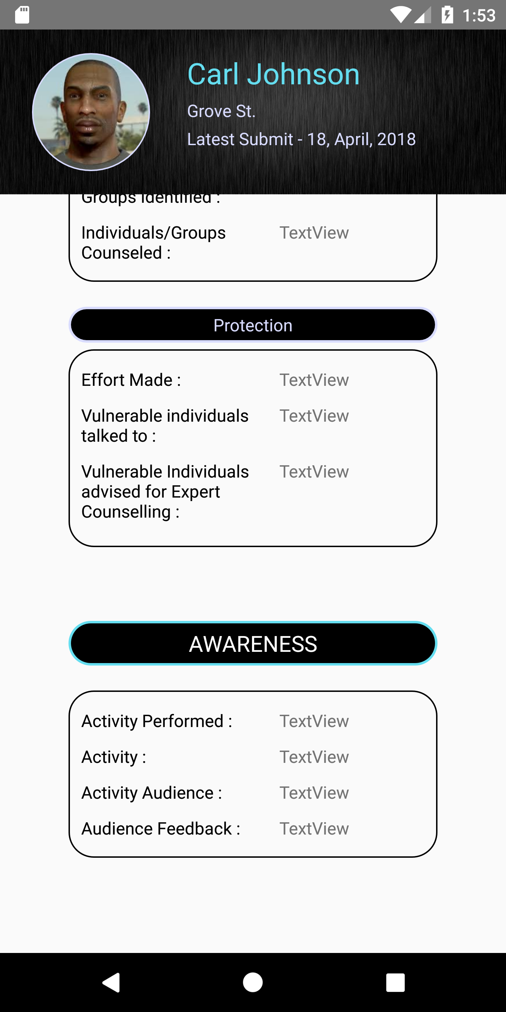
BRIEF PROGRESS
Shortened version of DAPO’s activities

Slide 43
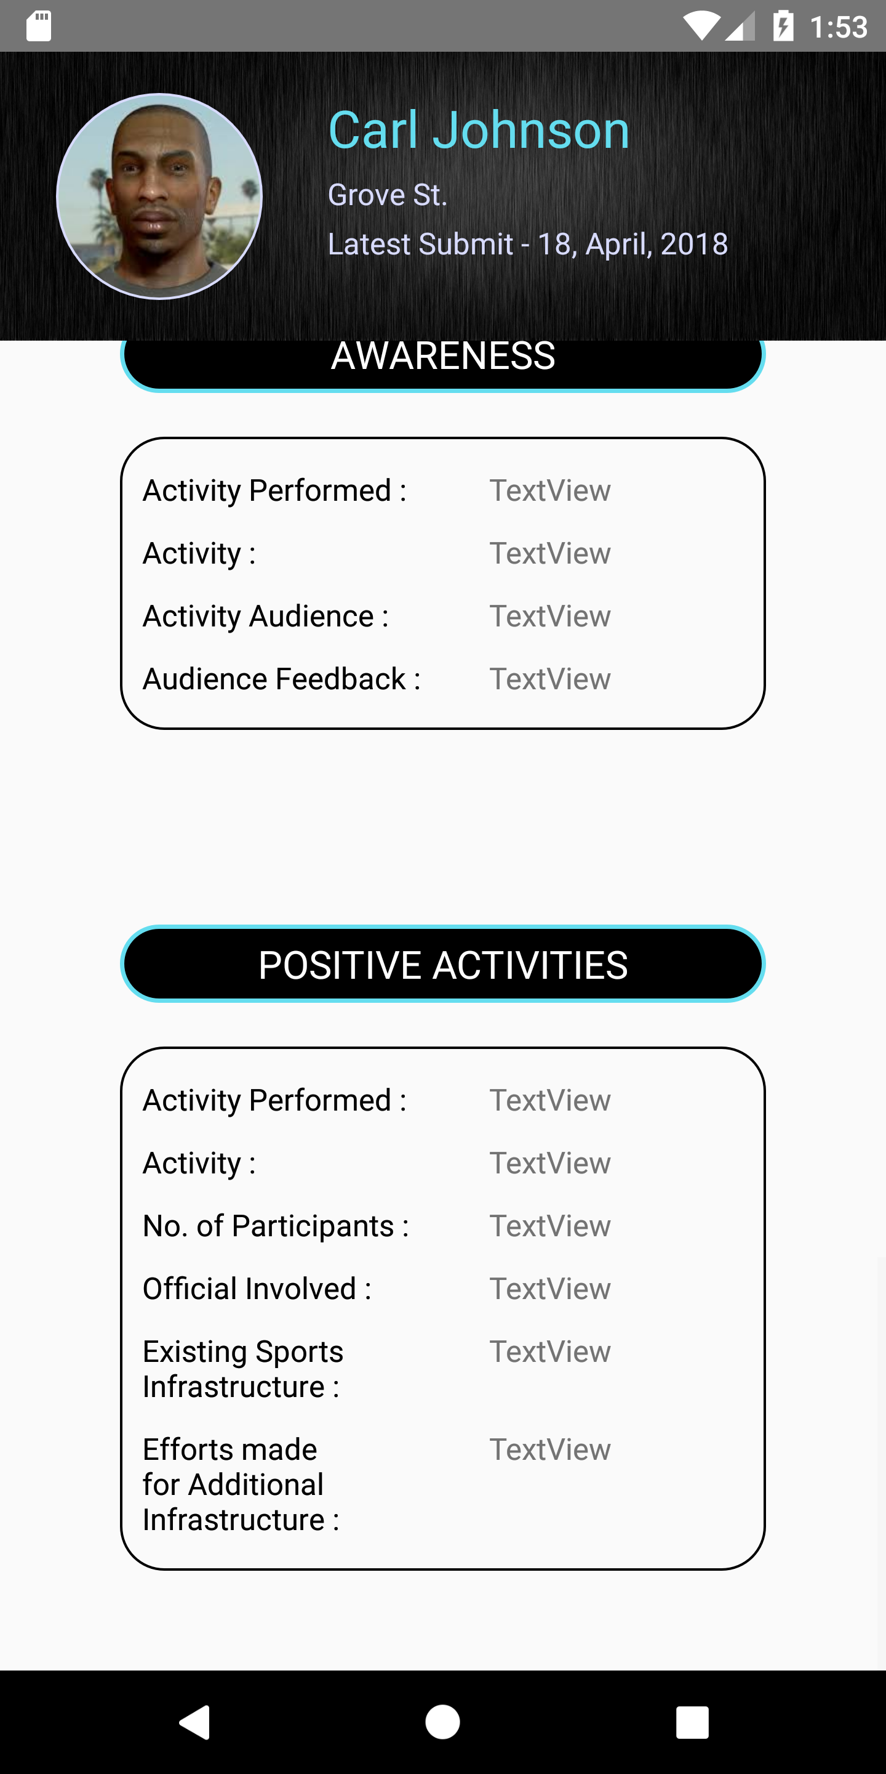
BRIEF PROGRESS
Shortened version of DAPO’s activities

Slide 44
database
First ,we will have a database of registered users.
Then database of feedback form from DAPO app which will be redirected to NRNC app for evaluation
Which will then be forwarded to other hierarchies for re-evaluation.

Slide 45
Under work

Slide 46
Detailed description
Once the database is linked, each feedback form will be displayed with all the inputs given

Slide 47
Report page
Format of the report to be given by each level, which can be reviewed by the higher levels

Slide 48
DAPO achievers
DAPO of the month etc. on the basis of:
No. of drug abuse victims identified
No. of vulnerable groups protected
No. of drug abuse victims sent to de-addiction centres
No. of meetings held for awareness
No. of positive activities undertaken

Slide 49
Translation to Punjabi will be done soon

Slide 50
Thank you

